Slide 1

AI Workshop
Faculty of Computer Science and Information Technology

Slide 2
Content
Introduction to machine learning
Classification
Regression

Slide 3
Learning Outcome
By the end of the session, you will be able to develop at least one AI model for classification / regression.

Slide 4
Machine Learning
Artificial Intelligence
A technique which enables machines to mimic human behaviour
Artificial Intelligence
Machine Learning
Machine Learning
Subset of AI technique which uses statistical methods to enable machines to improve with experience.
Deep Learning
Deep Learning
Subset of Machine Learning which make the computation of multi-layer neural network feasible

Slide 5
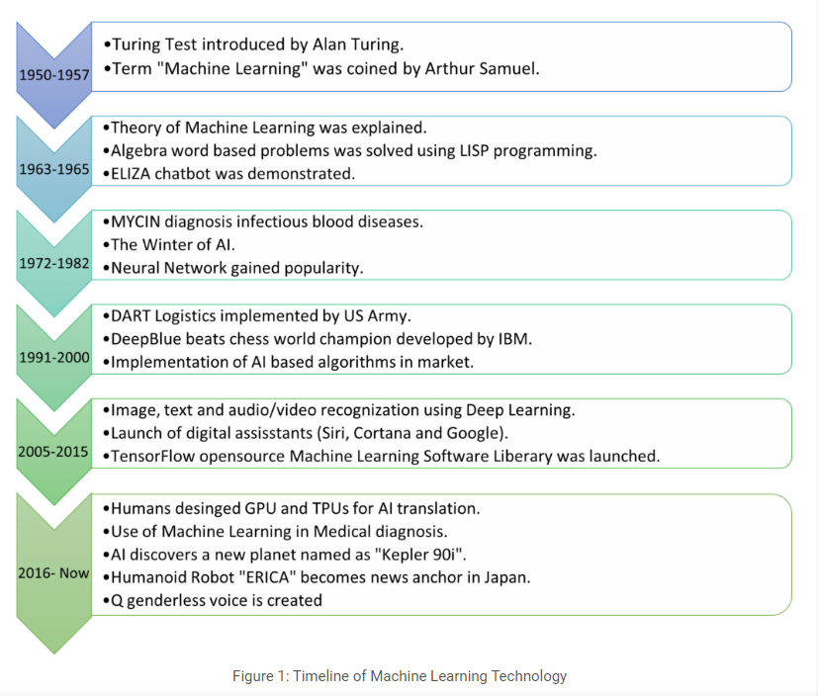
History
Source: https://insights2techinfo.com/future-scope-of-machine-learning-and-ai-in-2022/

Slide 6
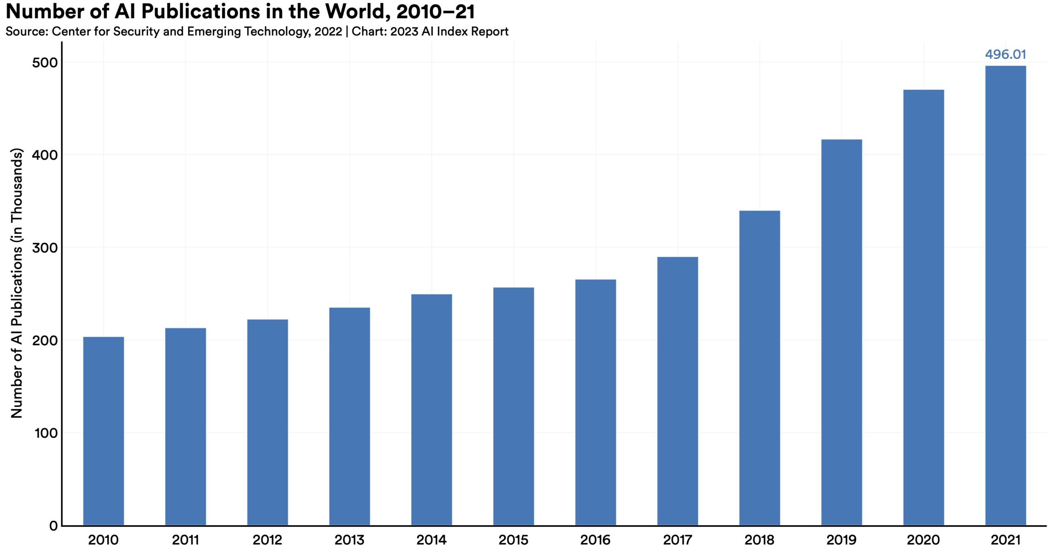
No. AI Publication from Stanford University HAI
The total number of AI publications has more than doubled since 2010. The specific AI topics that continue to dominate research include pattern recognition, machine learning, and computer vision.
Source: https://aiindex.stanford.edu/report/

Slide 7
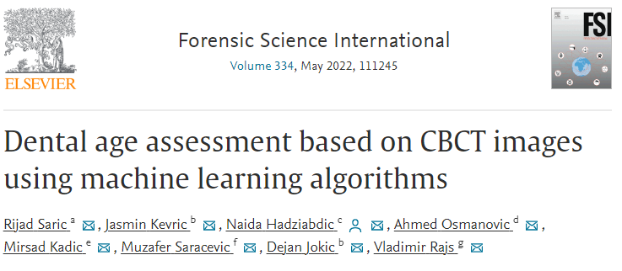
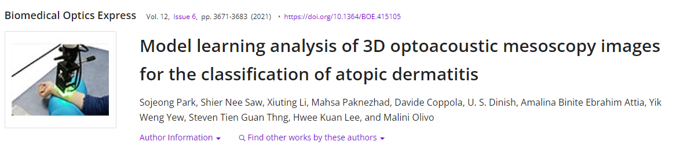
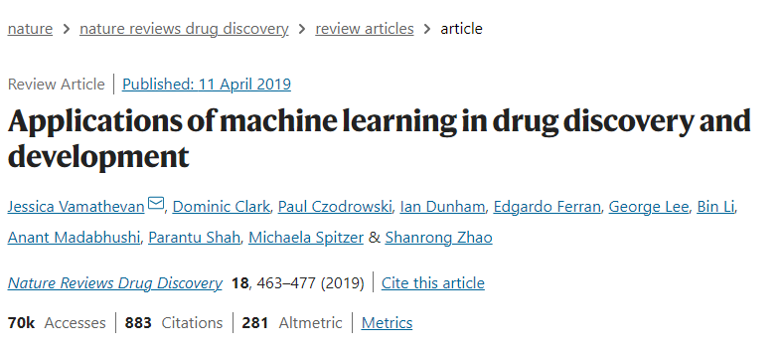
Some AI studies

Slide 8

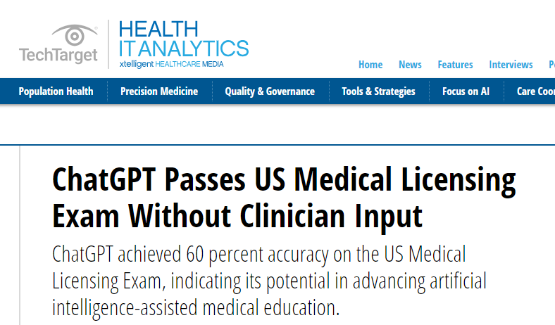
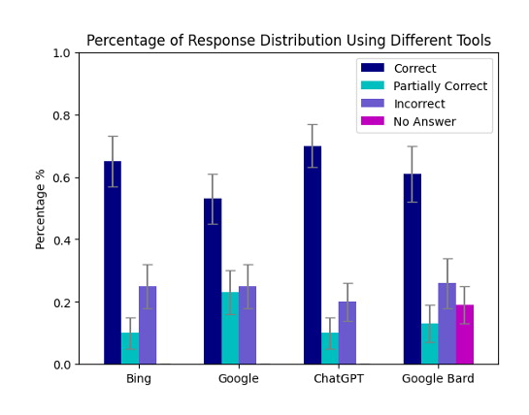
ChatGPT
Neither ChatGPT nor Google Bard, Bing and Google search engines answered all questions correctly and with 100% consistency.
Source: https://pubs.rsna.org/doi/10.1148/radiol.230922

Slide 9
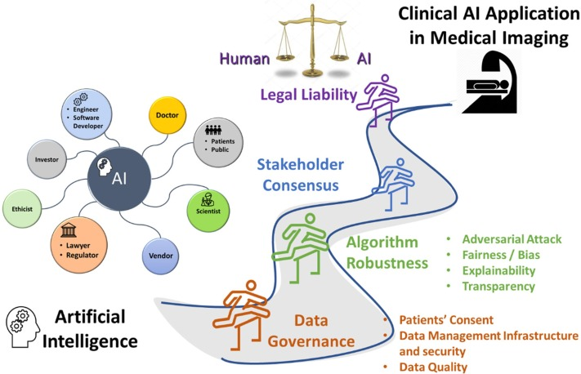
Challenges of implementing AI in Hospital
Source: https://www.sciencedirect.com/science/article/pii/S1120179722019962

Slide 10
How do we learn?

Slide 11



How do we learn?
Learning
Input
- Experience / Data
Output
- Task (Recognize color)
Test their performance – Quiz / Exam

Slide 12

How we train machine to learn?
Learning
Input
- Experience / Data
Output
- Task (Recognize color)
Test model performance – Accuracy, F1 score, MSE, …

Slide 13
What happen to human intelligence if
Input
Output
Unclear input
Unclear output
Precise Input
Precise output

Slide 14
Same thing happen in machine
Input
Output
GIGO
Unclear input
Unclear output
Garbish In Garbish Out
Precise Input
Precise output

Slide 15
Artificial Intelligence Techniques
Supervised Learning
Reinforcement Learning
Unsupervised Learning
Discover patterns in the data that relate data attributes with a target (class) attribute.
The data have no target attribute.
Interacts with environment, decide action, learns by trial and error method

Slide 16
Supervised Learning
is a machine learning paradigm for problems where the available data consists of labeled examples, meaning that each data point contains features (covariates) and an associated label.
Goal of supervised learning algorithms is learning a function that maps feature vectors (inputs) to labels (output), based on example input-output pairs.

Slide 17
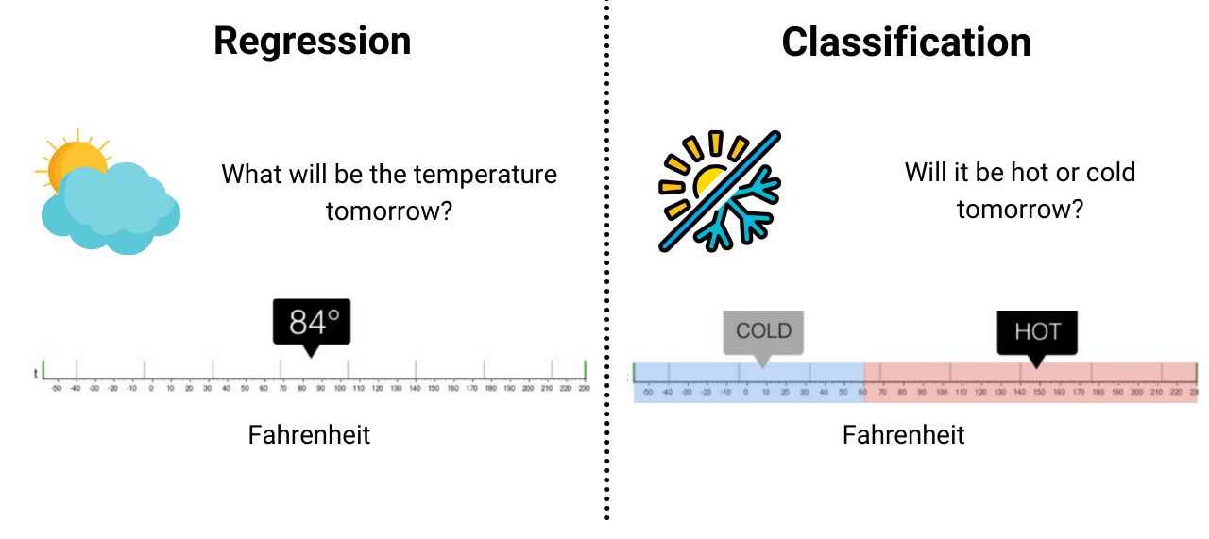
Supervised Learning
Continuous Variable
Categorical Variable

Slide 18
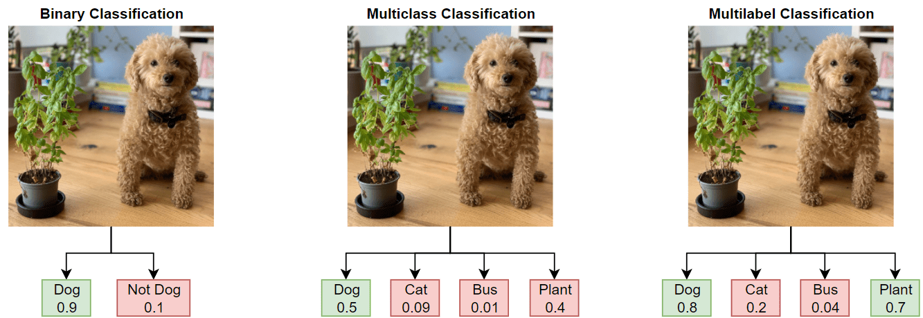
Type of Classification Problems
Source: https://www.mathworks.com/help/deeplearning/ug/multilabel-image-classification-using-deep-learning.html

Slide 19
Features and labels
The following terms are used interchangeably:
Row, observation, datapoint, instance
Column, attribute, feature
Target attribute, target, label
A target attribute is one we are interested in predicting

Slide 20
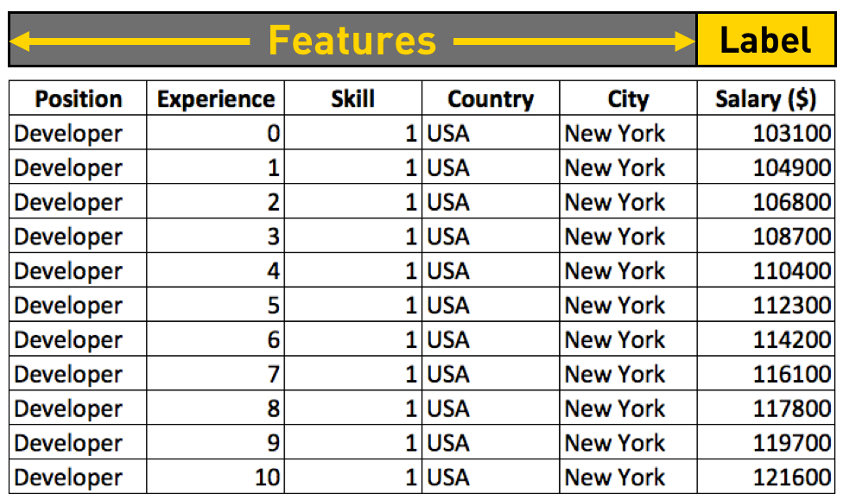
Features and Labels
Tabular Data

Slide 21
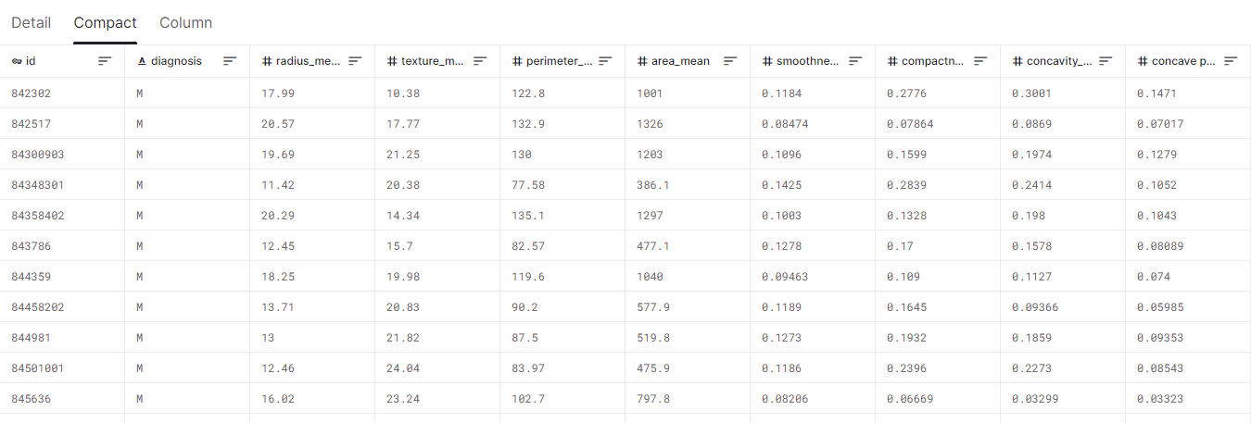
Features and Labels
Tabular Data – Breast cancer datasets
Features
Label
Source: https://www.kaggle.com/datasets/uciml/breast-cancer-wisconsin-data

Slide 22
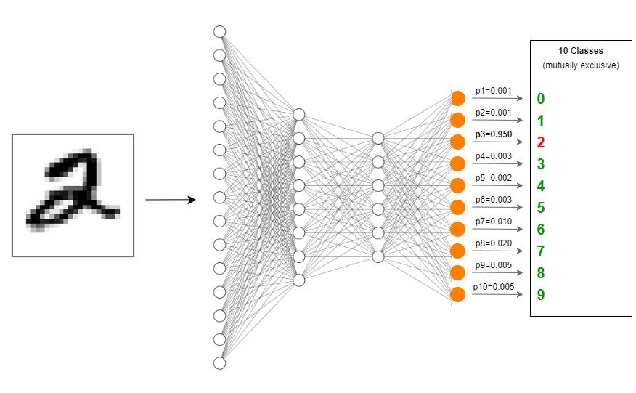
Features and Labels
Image Data
Label
Extracted Feature by D-CNN
Source: https://towardsdatascience.com/creating-a-multilayer-perceptron-mlp-classifier-model-to-identify-handwritten-digits-9bac1b16fe10

Slide 23
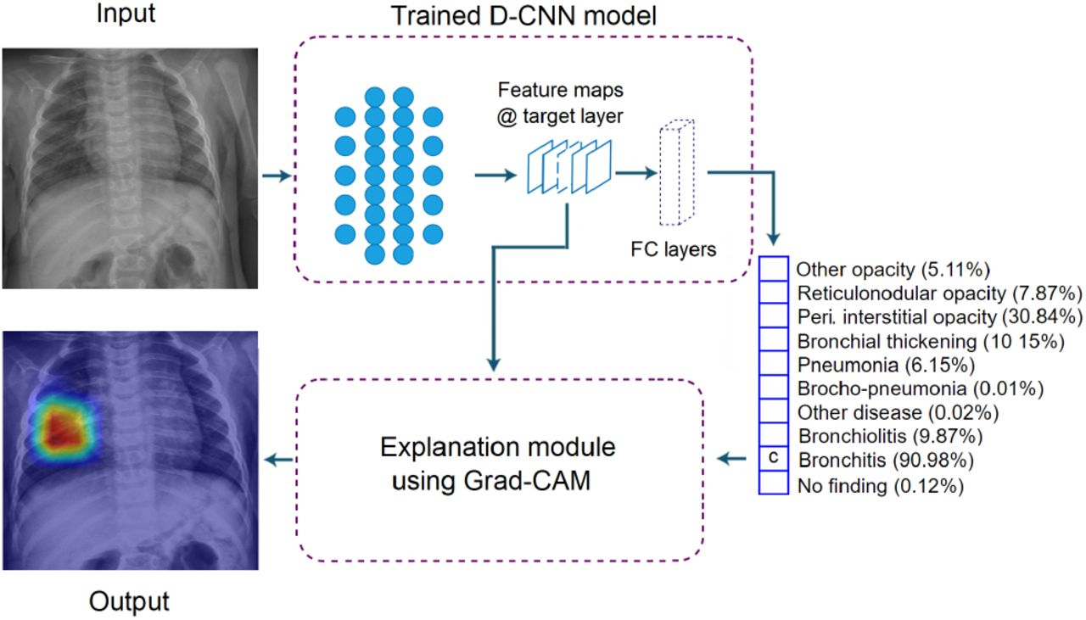
Features and Labels
Image Data
Extracted Feature by D-CNN
Label
Source: https://www.medrxiv.org/content/10.1101/2021.08.12.21261954v1.full

Slide 24
Number of Samples Needed
It depends.! No one know.
The complexity of the problem, nominally the unknown underlying function that best relates your input variables to the output variable.
The complexity of the learning algorithm, nominally the algorithm used to inductively learn the unknown underlying mapping function from specific examples.
A starting point:
Number of samples = Number of class * 1000
Number of samples = Number of features * 10 for machine learning
Number of samples = Number of weights * 50 for Artificial Neural Network [1]
[1] Alwosheel, A., van Cranenburgh, S., & Chorus, C. G. (2018). Is your dataset big enough? Sample size requirements when using artificial neural networks for discrete choice analysis. Journal of choice modelling, 28, 167-182.

Slide 25
Data Splitting
Training Data
Test Data
70%
30%
Train
Model
Test
In medical, it is important to do patient-level split to avoid data leakage.

Slide 26
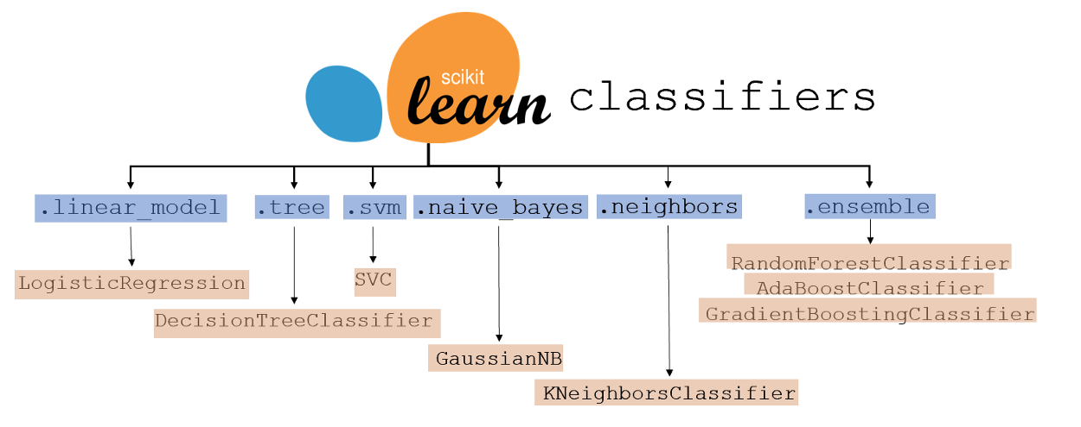

Classifiers Model
Machine Learning
Deep Learning
Convolutional Neural Network

Slide 27
Data Splitting
Training Data
Testing Data

Slide 28
Classifiers Evaluation
Training Data
Prediction
M
M
M
M
M
M
M
M
M
M
Testing Data

Slide 29
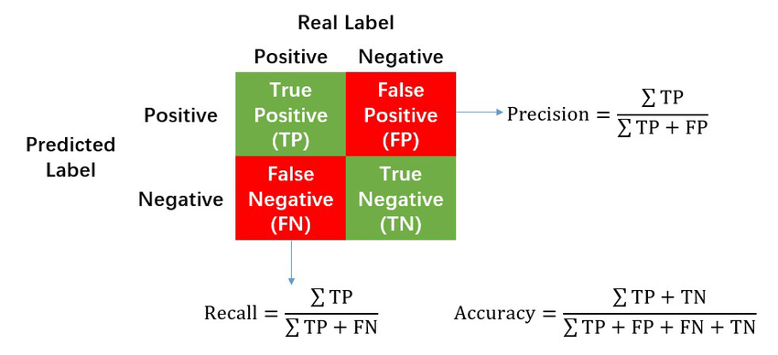
Classifiers Evaluation Metrics
Confusion Matrix
https://en.wikipedia.org/wiki/Confusion_matrix

Slide 30
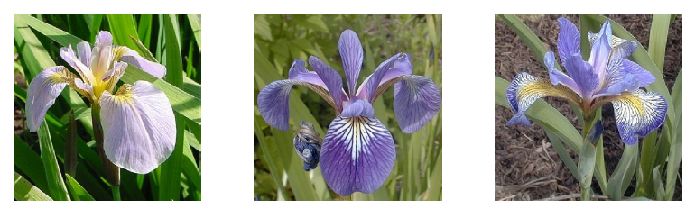
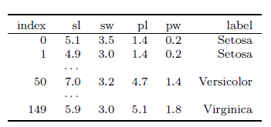

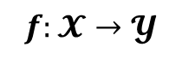


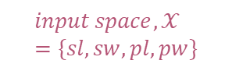
Example:
Input
Output
$$input space,𝒳=\{sl, sw, pl, pw\}$$
$$𝓨$$
$$𝓨$$
$$f:𝓧→𝓨$$
$$input space,𝒳=numeric features$$

Slide 31
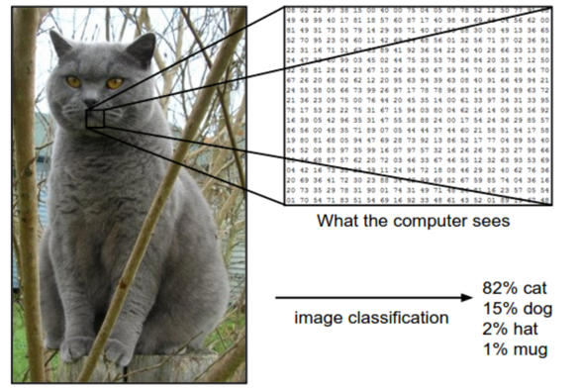
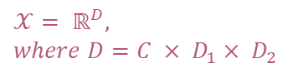

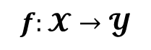
Example:
Input
Output
$$𝓨$$
$$𝒳= ℝ^{D}, where D=C × D_{1}× D_{2}$$
$$𝓨$$
$$f:𝓧→𝓨$$
$$input space,𝒳=sets of images$$

Slide 32
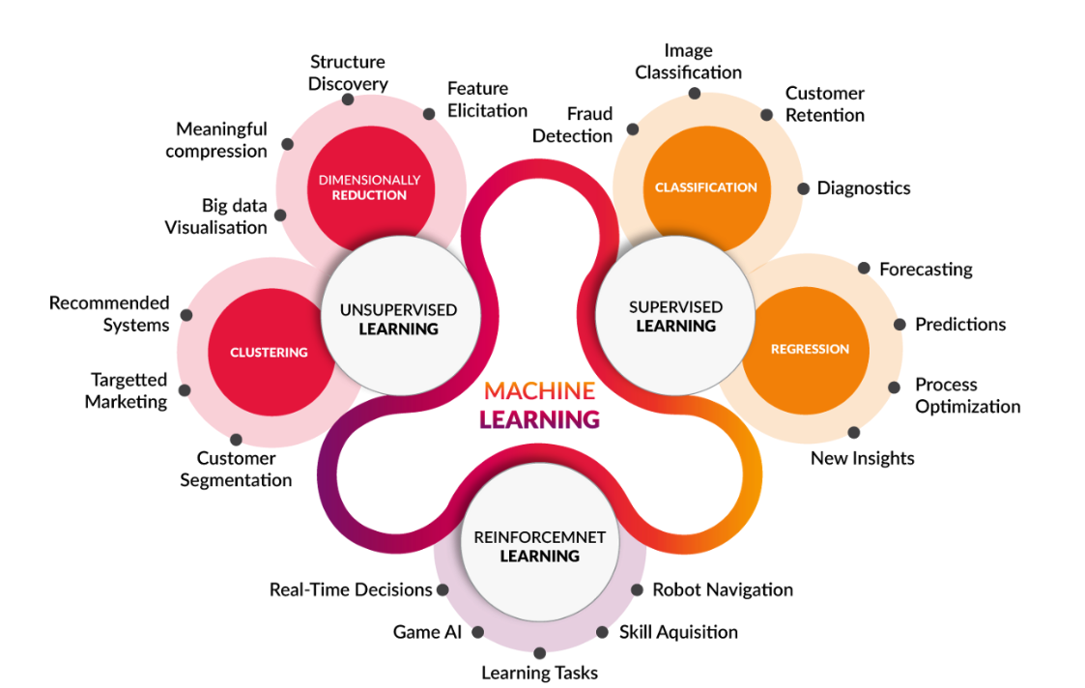
Machine Learning
https://medium.com/@yadavdeepika729/different-machine-learning-models-2387575e64cd

Slide 33
Regression
y
Process of estimating the relationship between a dependent variable and independent variables.
x

Slide 34

Regression
Pause and think about some possible example on regression problem.
https://www.springboard.com/blog/data-science/regression-vs-classification/

Slide 35
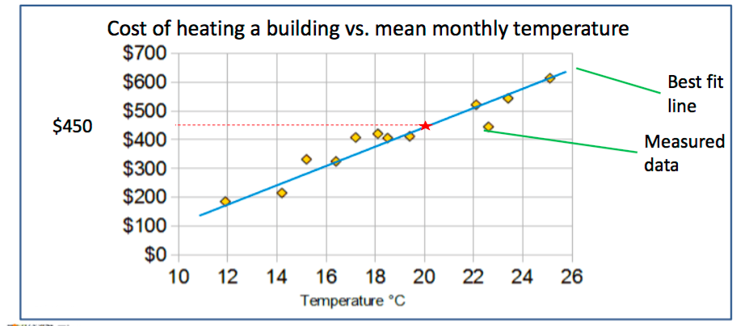
Regression
Regression predicts a target attribute which is a number (as opposed to a category)
The simplest regression is a best fit line

Slide 36
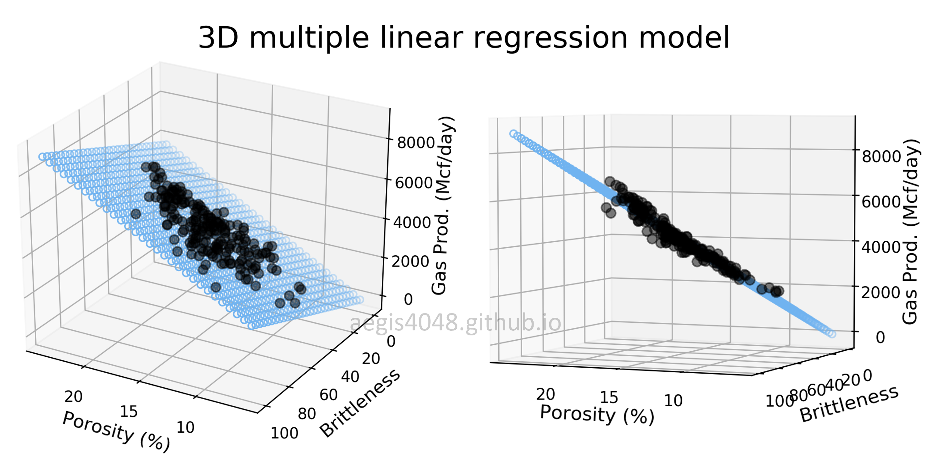
Regression
https://aegis4048.github.io/mutiple_linear_regression_and_visualization_in_python

Slide 37
Regression – Developing ML model
Data Preparation
Data Splitting (Train/Test)
Model Training
Model Evaluation
Data | Feature1 | Feature2 | Prediction | Temp.
Data1 | 23 | 3 |  | 32
Data2 | 12 | 51 |  | 29
Data3 | 1 | 12 |  | 24
… | … | … |  | …
DataN | 15 | 65 |  | 38

Slide 38
Regression – Developing ML model
Data Preparation
Data Splitting (Train/Test)
Model Training
Model Evaluation
Data | Feature1 | Feature2 | Prediction | Temp.
Data1 | 23 | 3 |  | 32
Data2 | 12 | 51 |  | 29
Data3 | 1 | 12 |  | 24
… | … | … |  | …
DataN | 15 | 65 |  | 38
70%
Training
30%
Test

Slide 39
Regression – Developing ML model
Data Preparation
Data Splitting (Train/Test)
Model Training
Model Evaluation
Use only training data to train the model
Data | Feature1 | Feature2 | Prediction | Temp.
Data1 | 23 | 3 |  | 32
Data2 | 12 | 51 |  | 29
Data3 | 1 | 12 |  | 24
… | … | … |  | …
DataN | 15 | 65 |  | 38
70%
Training

Slide 40
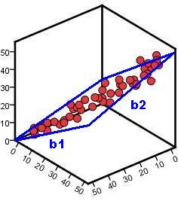
Regression – Developing ML model
Data Preparation
Data Splitting (Train/Test)
Model Training
Model Evaluation
Example of linear regression
Temperature
Feature 1
Feature 2

Slide 41
ML Model – Regression Evaluation Metrics
Data Preparation
Data Splitting (Train/Test)
Model Training
Model Evaluation
Use only testing data to evaluate the model
Data | Feature1 | Feature2 | Prediction | Label
Data1 | 23 | 3 | Cold | Cold
Data2 | 12 | 51 | Cold | Hot
Data3 | 1 | 12 | Hot | Hot
… | … | … | … | …
DataN | 15 | 65 | Hot | Cold
30%
Test
https://en.wikipedia.org/wiki/Confusion_matrix

Slide 42
ML Model – Regression Evaluation Metrics
Data Preparation
Data Splitting (Train/Test)
Model Training
Model Evaluation
A perfect model should predict all testing data correctly → Mean Square Error = 0
Data | Feature1 | Feature2 | Prediction | Label
Data1 | 23 | 3 | Cold | Cold
Data2 | 12 | 51 | Cold | Hot
Data3 | 1 | 12 | Hot | Hot
… | … | … | … | …
DataN | 15 | 65 | Hot | Cold
30%
Test

Slide 43
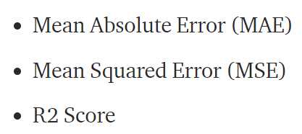
ML Model – Regression Evaluation Metrics
Data Preparation
Data Splitting (Train/Test)
Model Training
Model Evaluation
https://medium.com/@parag.jain164/performance-matrix-for-regression-model-c9ba0d2cae33

Slide 44
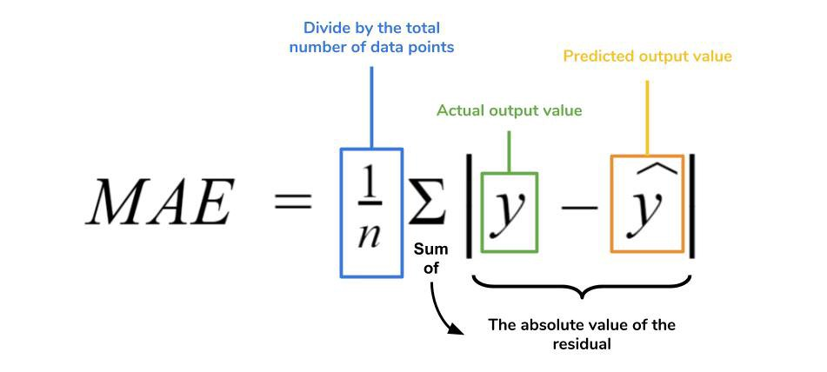
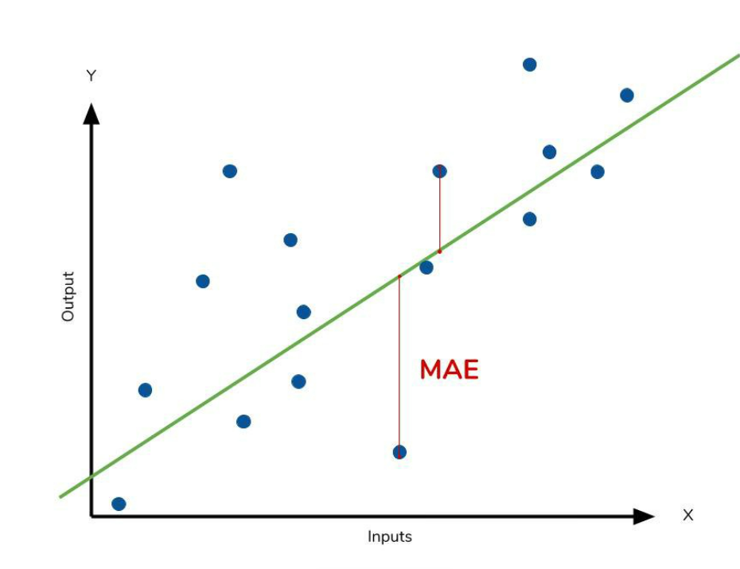
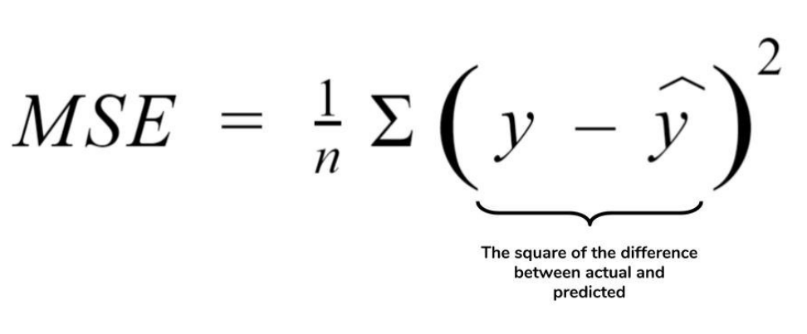
ML Model – Regression Evaluation Metrics
Data Preparation
Data Splitting (Train/Test)
Model Training
Model Evaluation
https://medium.com/ml-cheat-sheet/machine-learning-evaluation-metrics-b89b8832e275

Slide 45
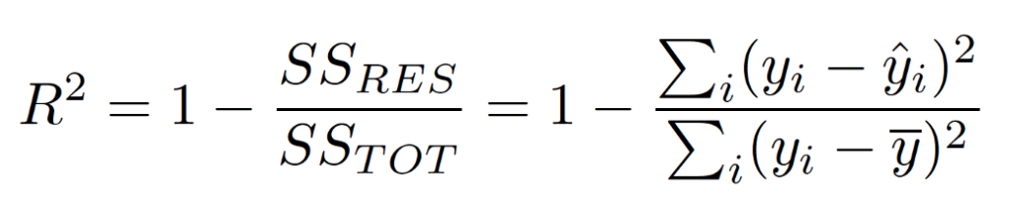
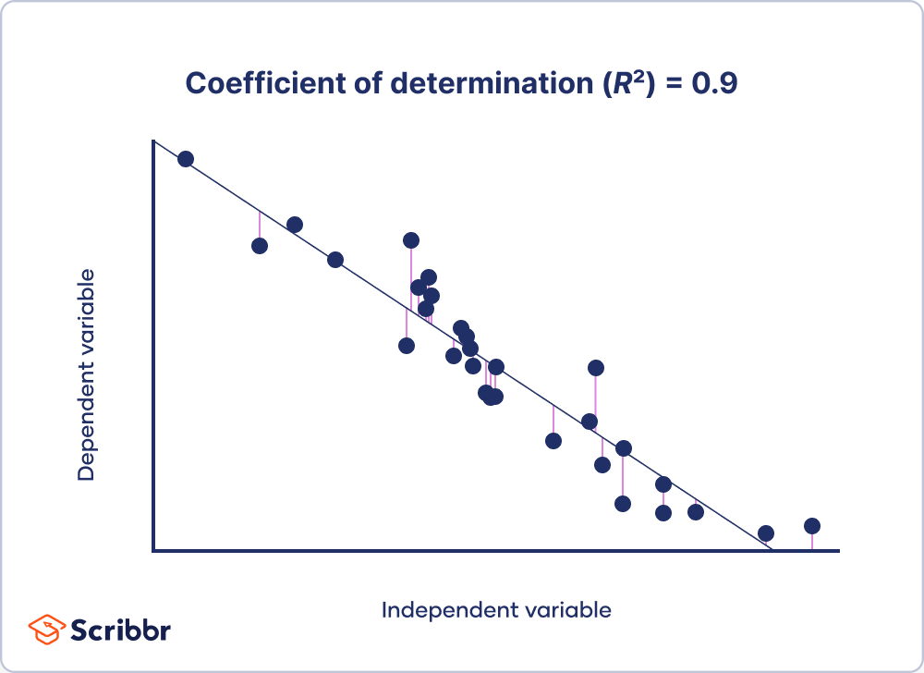
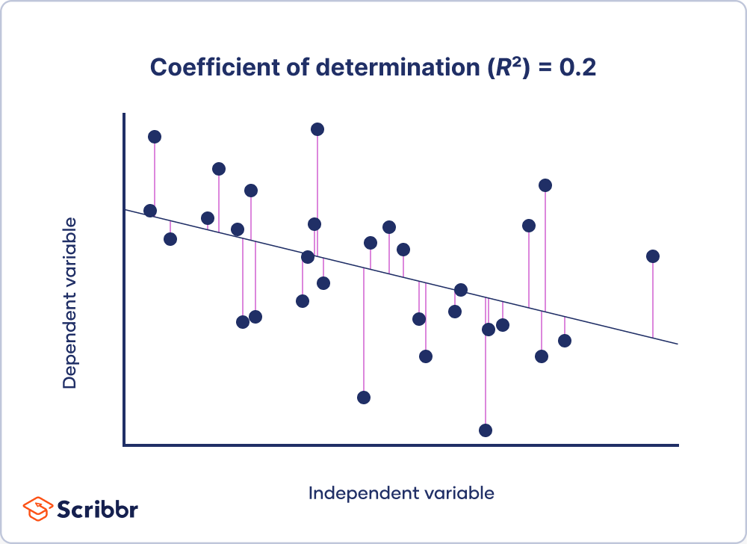
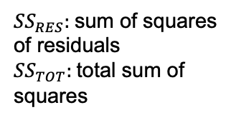
ML Model – Regression Evaluation Metrics
Data Preparation
Data Splitting (Train/Test)
Model Training
Model Evaluation
${SS}_{RES}:$sum of squares of residuals
${SS}_{TOT}:$total sum of squares
https://www.scribbr.com/statistics/coefficient-of-determination/

Slide 46
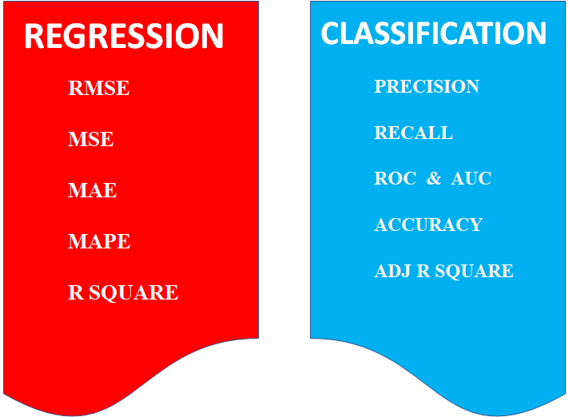
ML Model – Evaluation Metrics
https://medium.com/odscjournal/are-we-choosing-the-right-evaluation-metrics-how-to-choose-it-ee01fcf34b9

Slide 47
Corresponding Code
Data Preparation
Data Splitting (Train/Test)
Model Training
Model Evaluation
pd.read_csv()
sklearn.model_selection.train_test_split()
model.fit()
model.predict()

Slide 48
Summary
Classification → predict categorical variable
Regression → predict continuous variable
Machine Learning Process
Data Preparation
Data Split
Model Training
Model Evaluation

Slide 49

Additional Reading
Your First Machine Learning Project in Python Step-By-Step https://machinelearningmastery.com/machine-learning-in-python-step-by-step/
4 Types of Classification Tasks in Machine Learning https://machinelearningmastery.com/types-of-classification-in-machine-learning/
Machine Learning Classifiers https://towardsdatascience.com/machine-learning-classifiers-a5cc4e1b0623
Save and Load Machine Learning Models in Python with scikit-learn https://machinelearningmastery.com/save-load-machine-learning-models-python-scikit-learn/
scikit-learn Linear Regression documentation
https://scikit-learn.org/stable/modules/generated/sklearn.linear_model.LinearRegression.html
Hands-on exercise on linear regression
https://colab.research.google.com/github/csmastersUH/data_analysis_with_python_2020/blob/master/linear_regression.ipynb

